Slide 1
Last Week
This Week
Additive Reinforcement Learning Algorithm (ARLA)
2D structure
Lumerical FDTD + Python
Lumerical FDTD + Python

Slide 2
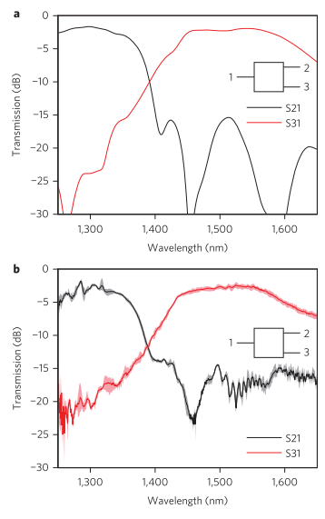
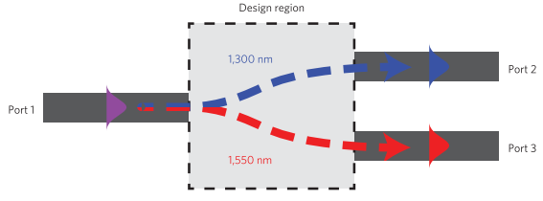
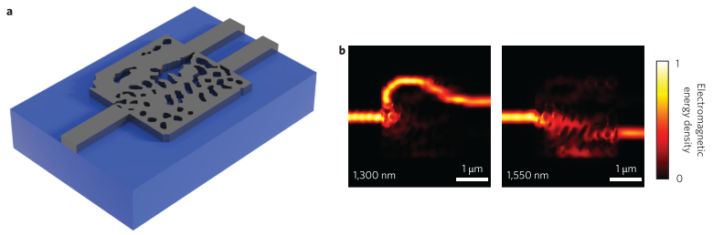
2015-nature photonics-vol 9-Inverse design and demonstration of a compact and broadband on-chip wavelength demultiplexer (Alexander Y. Piggott, Jesse Lu, Konstantinos G. Lagoudakis, Jan Petykiewicz, Thomas M. Babinec, Jelena Vuckovic)
SOI: silicon-on-insulator

Slide 3
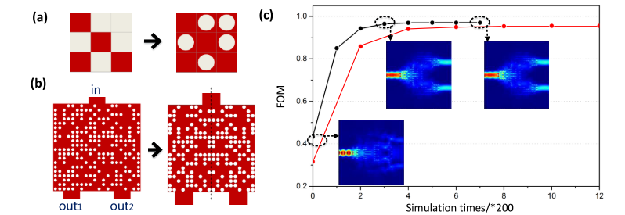
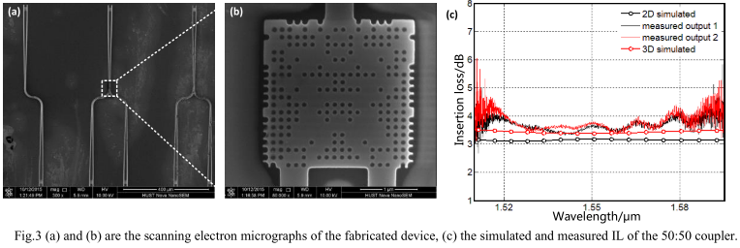

2016-Optical Fiber Communications Conference and Exhibition-An Ultra compact 50:50 Coupler Based on PhC like Metamaterial Structure (Luluzi Lu, Minming Zhang, Feiya Zhou, Deming Liu)
PhC like metamaterial: photonic-crystal-like metamaterial
$$FOM=1−\left(1−α\right)\left(\left|t_{1}−0.5\right|+\left|t_{2}−0.5\right|\right)−α∙\left|t_{1}−t_{2}\right|$$
, Set to $α=0$
symmetric
random
random
symmetric

Slide 4
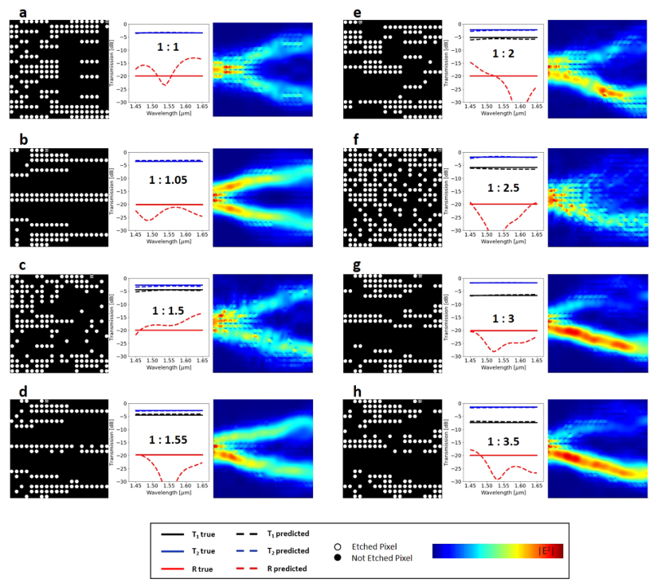
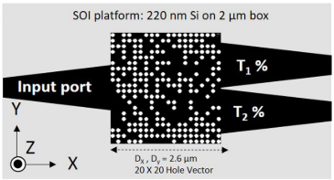
2019-Scientific Reports-9, 1368-Deep Neural Network Inverse Design of Integrated Photonic Power Splitters (Mohammad H. Tahersima, Keisuke Kojima, Toshiaki Koike-Akino, Devesh Jha, Bingnan Wang, Chungwei Lin, Kieran Parsons)
SOI: silicon-on-insulator

Slide 5
Beam Splitter

